Slide 1


EDA Project on Restaurant Food Quality
Classification
-By
KUSHAL BABU S
Business Analytics Intern
Under the Guidance of:
RAPAKA MANOJ KUMAR
Data Science Trainer

Slide 2
INTRODUCTION
This project focuses on analyzing restaurant food quality using Exploratory Data Analysis (EDA).
The goal is to understand customer perceptions of food quality and identify key factors affecting food ratings.
This analysis helps identify areas where food quality meets customer expectations and highlights opportunities for improvement to ensure consistent and high-quality dining experiences.

Slide 3
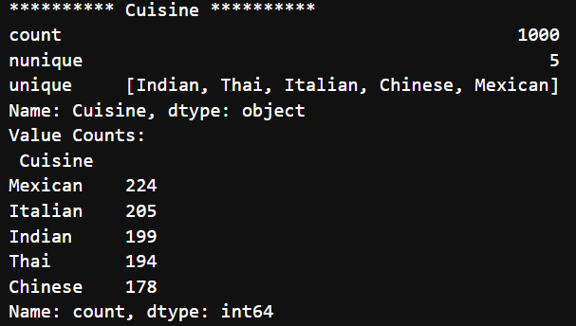
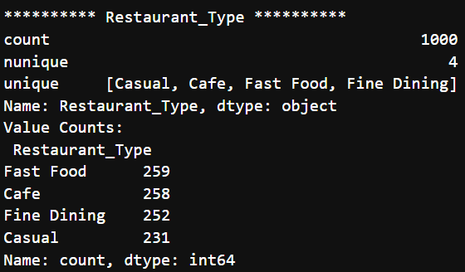
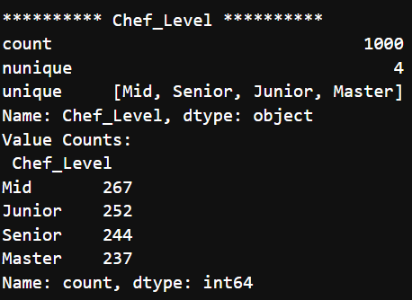
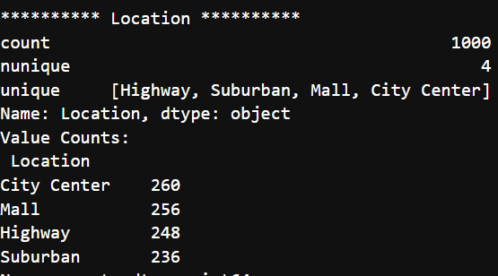
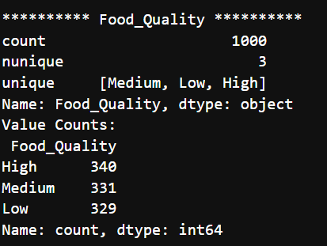
Data Overview
Categorical Data

Slide 4
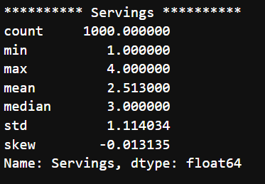
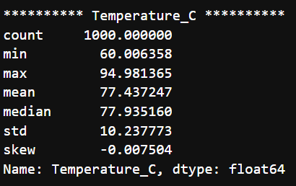
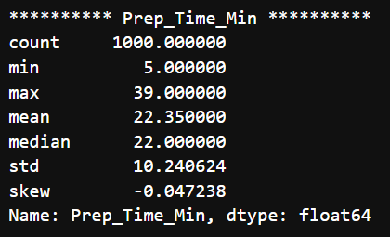
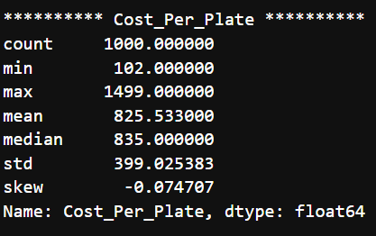
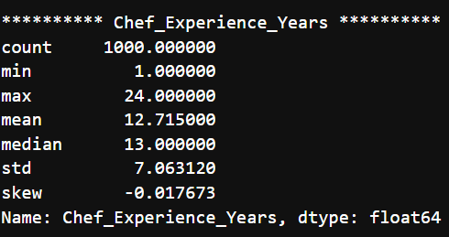
Data Overview
Numerical Columns

Slide 5
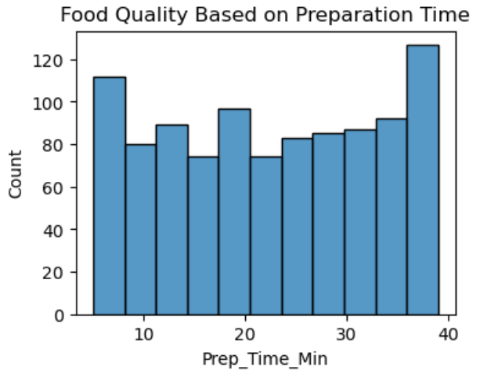
Univariate Analysis – Preparing Time
Preparation time varies, indicating both quick and time-intensive dishes.
Most dishes fall within a moderate preparation time range.
Longer preparation time generally reflects better food quality.
Extremely long preparation times may impact the customer waiting experience.

Slide 6
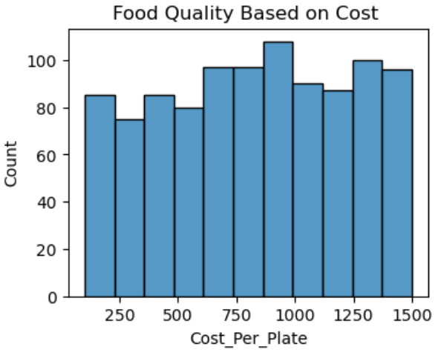
Food Quality Based On Cost
The cost per plate varies widely, indicating both budget-friendly and premium food options.
Most food items are priced in the mid-range, suggesting a balance between affordability and quality.
Higher-cost dishes are present in smaller numbers and are often associated with better food quality.
Cost influences food quality perception, but a higher price does not always guarantee better quality.

Slide 7
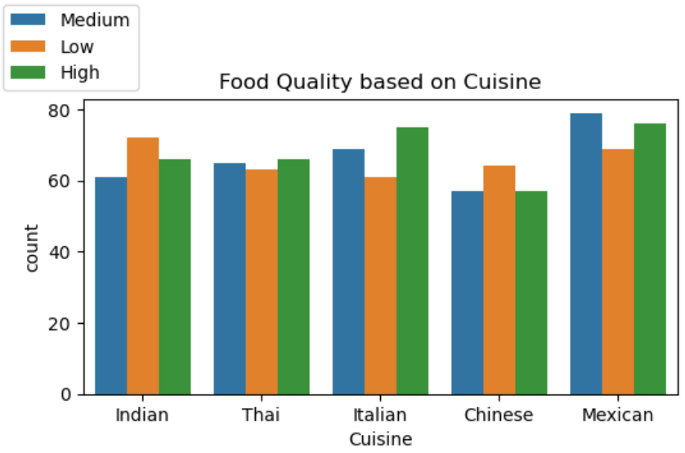
Bivariate Analysis
Food Quality Based on Cuisine
Food quality varies across different cuisines, indicating differences in preparation style and customer preferences.
Italian and Mexican cuisines show a higher count of high food quality ratings compared to other cuisines.
Chinese cuisine has relatively more low to medium quality ratings, suggesting scope for improvement.
Overall, cuisine type plays a significant role in determining perceived food quality.

Slide 8
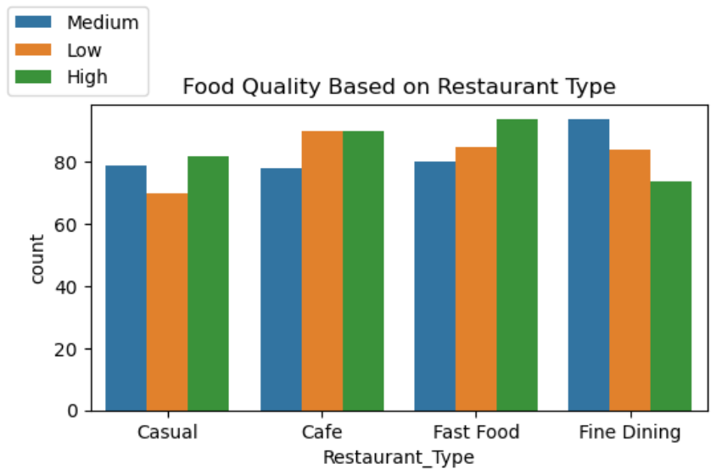
Food Quality Based on
Restaurant Type
Fine dining restaurants show a higher count of medium to high food quality ratings, reflecting better consistency.
Cafes and Fast food outlets also receive a significant number of high food quality ratings, showing good customer acceptance.
Casual restaurants display relatively balanced ratings, suggesting moderate food quality across customers.

Slide 9
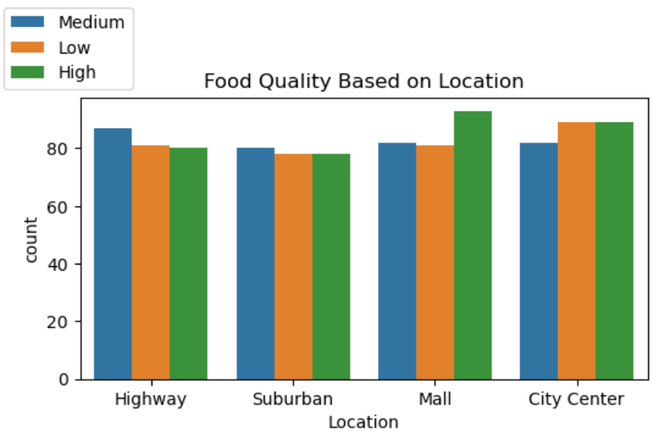
Food Quality Based on Location
Food quality varies across different restaurant locations.
Mall and city center locations show a higher number of high food quality ratings.
Suburban locations have relatively balanced food quality ratings.
Location plays a role in influencing perceived food quality.

Slide 10
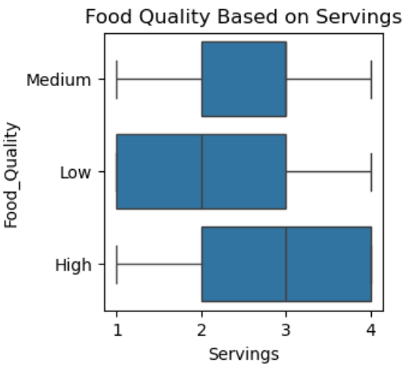
Food Quality Based on Servings
Higher food quality ratings are generally associated with larger serving sizes.
Low food quality shows smaller and more variable servings.
Medium quality has moderate serving sizes with less variation.
Portion size plays an important role in influencing food quality perception.

Slide 11
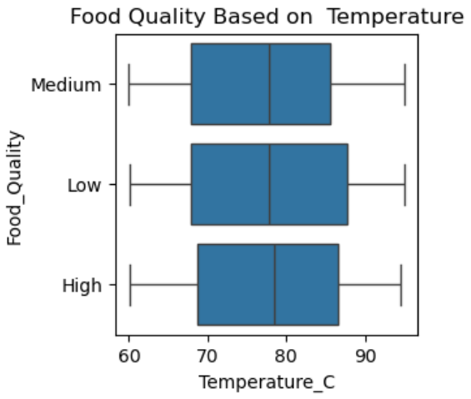
Food Quality Based on Temperature
Higher food quality ratings are associated with optimal serving temperatures.
Low food quality shows wider temperature variation, indicating inconsistent serving conditions.
Medium and high food quality have more consistent temperature ranges.
Maintaining proper serving temperature is important for better food quality perception.

Slide 12
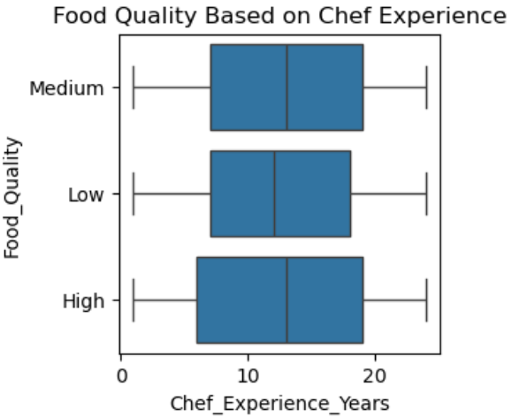
Food Quality Based on Chef Experience
Higher food quality ratings are generally associated with greater chef experience.
Low food quality shows lower and more variable chef experience levels.
Medium and high food quality categories have chefs with more consistent experience.
Chef experience plays an important role in delivering better food quality.

Slide 13
Overall Insights
Food quality is influenced by multiple factors, including preparation time, serving temperature, portion size, chef experience, cost, cuisine type, restaurant type, and location.
Optimal preparation time and consistent serving temperature are key contributors to higher food quality ratings.
Restaurants with experienced chefs, appropriate portion sizes, and premium offerings tend to achieve better food quality perception.
Cuisine type, restaurant type, and location also play a significant role in shaping customer’s food quality experience.

Slide 14
Recommendation
Maintain optimal preparation time and serving temperature to ensure consistent food quality.
Assign experienced chefs to maintain high food quality standards.
Standardize portion sizes to improve customer satisfaction.
Focus on improving food quality across cuisines, locations, and restaurant types.
Monitor cost-to-quality balance to ensure value for money.
Regularly collect customer feedback to improve food quality continuously.

Slide 15
Conclusion
Exploratory Data Analysis identified key factors affecting food quality.
Optimal preparation time and proper serving temperature improve food quality.
Chef experience and appropriate portion sizes contribute to better food quality.
Cuisine type, restaurant type, and location influence customer perception.
Data-driven insights can help restaurants improve food quality and customer satisfaction.

Slide 16
Thank You

